Slide 1
Non-Experimental Research

Slide 2
Non-experimental research
Non-experimental research – research that lacks the manipulation of an independent variable.
Measure variables as they naturally occur
Experiments provide evidence for changes caused by an IV. Non-experimental research cannot
Doesn’t mean that non-experimental research is less important.

Slide 3
When to use non-experimental?
Inappropriate, not feasible, not possible, not ethical to manipulate.
Non-experimental preferred when:
Question relates to a single variable rather than 2 or more variables
Question pertains to non-causal relationships (correlation between verbal intelligence and mathematical intelligence?)
Participants can’t be randomly assigned (e.g. brain damage)

Slide 4
Types of non-experimental research
Cross-sectional research
Comparing two or more pre-existing groups of people. No random assignment, no manipulation
50 Males / 50 Females
50 People with Hippocampus damage / 50 People with no damage
Observational research
Correlational Research

Slide 5

Observational Research
~ where behavior is systematically observed and recorded.
Want to describe a variable(s)
Naturalistic Observation
observe behavior in the environment where it occurs
Jane Goodall’s chimps
Disguised vs. undisguised.

Slide 6
Observational Research
Participant observation
Researchers become active participants in the group or situation.
Engaged, not just observing from behind.
Disguised vs. undisguised.
Structured Observation
Observations in settings that are more controlled/structured than natural environment
E.g. laboratory setting.

Slide 7
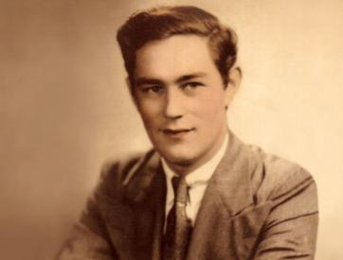
Observational Research
Case Studies
In depth examination of a single individual.
Often people who have rare/unusual conditions or disorders
Not feasible to run studies with multiple people.
The Case of H.M. (1953). Epileptic seizures, not responding to medication. Underwent bilateral resection of hippocampus.

Slide 8
Correlational Research
~ Statistical relationship between two variables.
No manipulation of an independent variable.
Measure two continuous variables.
E.g. number of hours studying and test performance.
Use correlational research when you can’t manipulate variables.

Slide 9
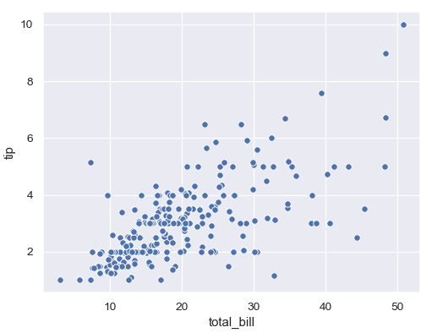
Correlational Research
Scatterplot

Slide 10
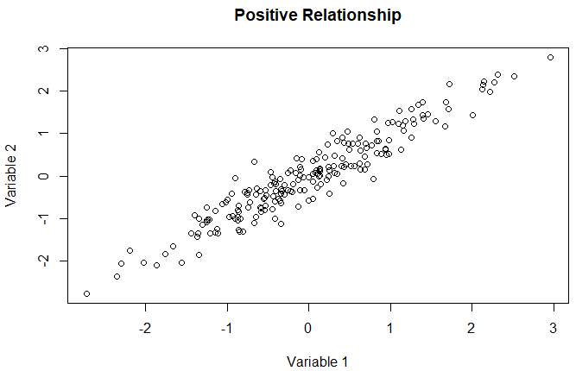
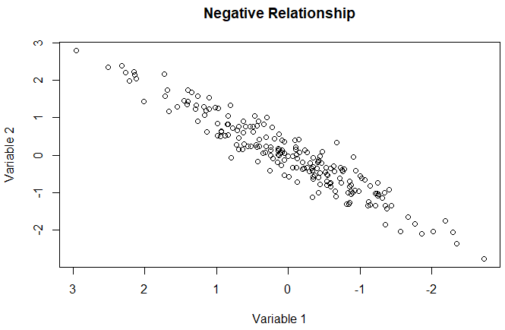
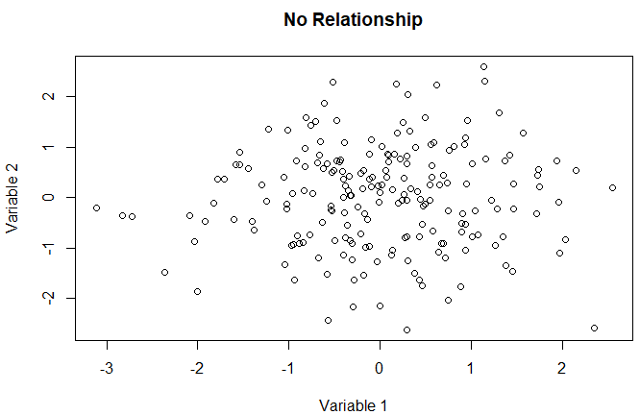
Correlational Research
r = .94
r = - .94
r = .03
An r of -.87 is stronger than an r of .67.
(absolute value)
Pearson’s correlation coefficient (r)

Slide 11
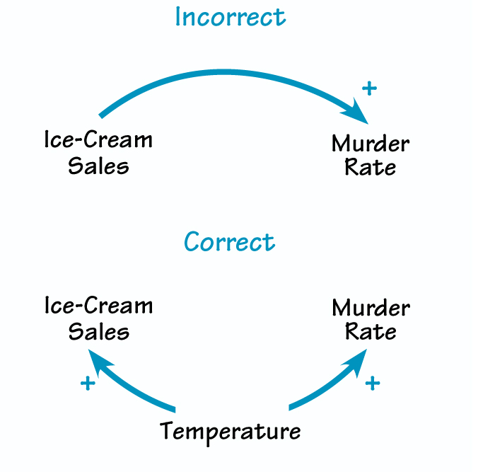
Correlation does not imply causation
Say it with me! Correlation does not mean causation!
For two reasons
Directionality problem
Third variable problem.
Spurious correlations

Slide 12
Correlation does not imply causation
Say it with me! Correlation does not mean causation!
For two reasons
Directionality problem
Third variable problem.
Spurious correlations

Slide 13
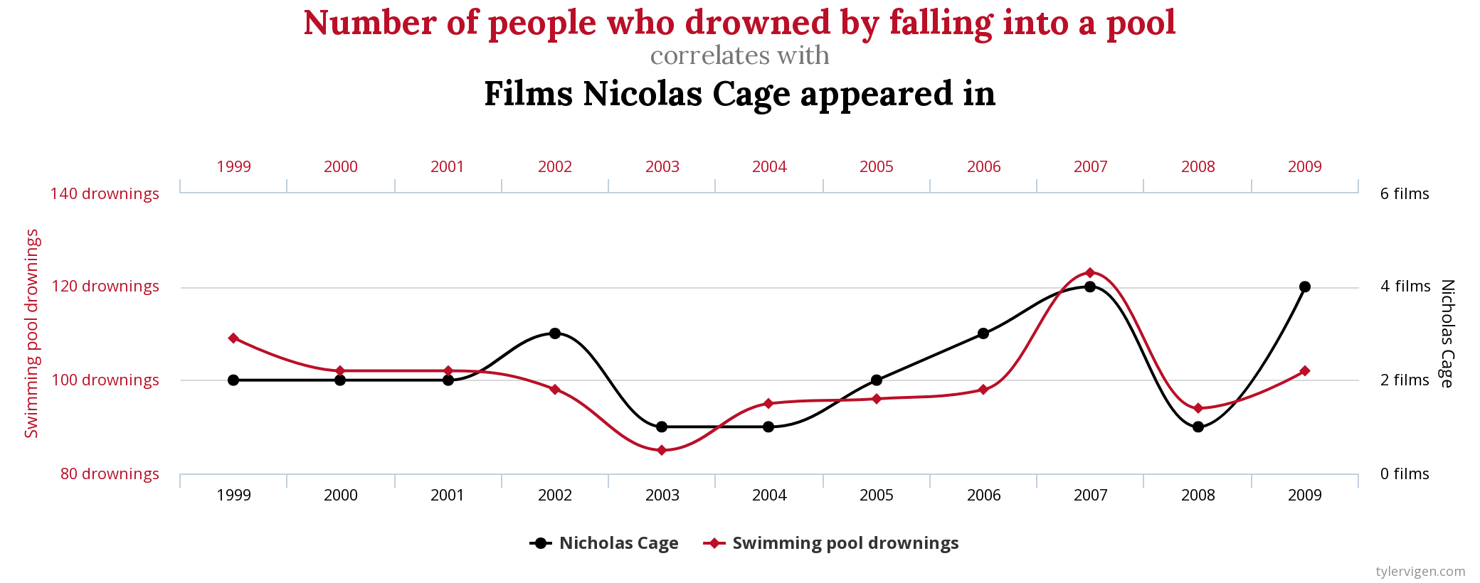
Spurious Correlations
http://www.tylervigen.com spurious correlations.

Slide 14
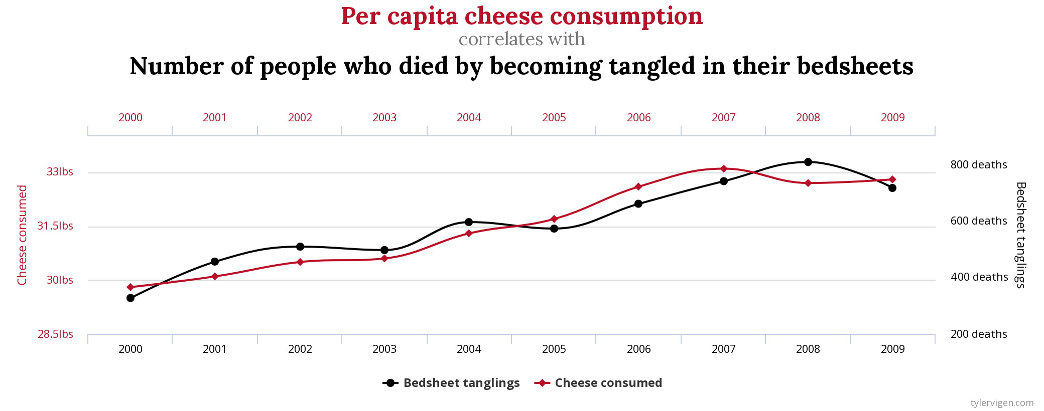
Spurious Correlations

Slide 15
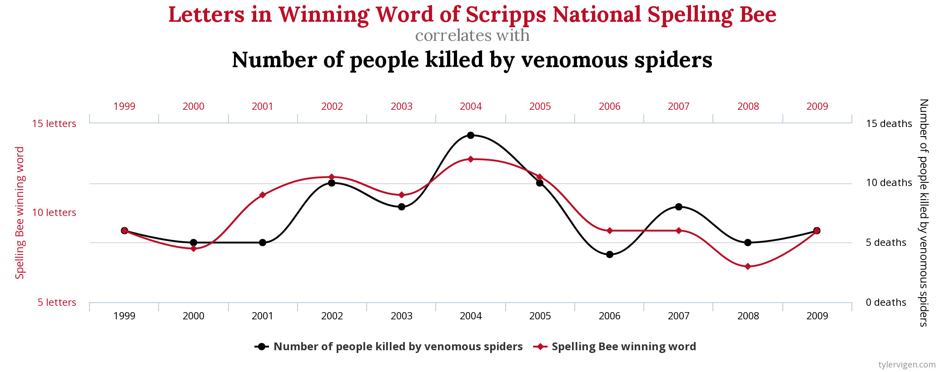
Spurious Correlations

Slide 16
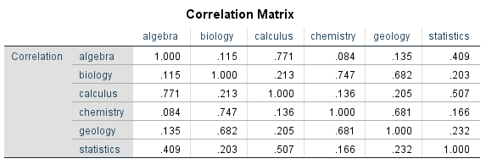
Complex correlations
> 2 variables.
Correlation matrix
Factor analysis
Big 5 Factors of personality
O C E A N

Slide 17
Controlling other variables.
Correlation is not causation
But you can use complex correlational research to rule out other plausible interpretations
Partial correlations
Violent TV & Aggression – r = .35
Violent TV & Aggression & SES – r = .33

Slide 18
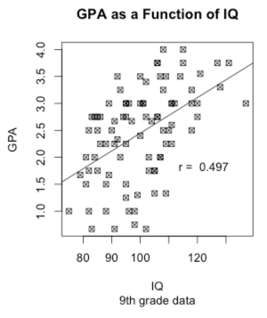
Regression
Establish relationship between two variables
Make predictions about the value of one variable given the value of another variable.
Interpreting regression slope coefficients.
b = .24
1 increase in X is associated with b increase in Y

